Slide 1
Sorting in Linear Time
Notes:
‹#›

Slide 2
Comparison Sorting Review
Insertion sort:
Pro’s:
Easy to code
Fast on small inputs (less than ~50 elements)
Fast on nearly-sorted inputs
Con’s:
O(n²) worst case
O(n²) average case
O(n²) reverse-sorted case

Slide 3
Comparison Sorting Review
Merge sort:
Divide-and-conquer:
Split array in half
Recursively sort sub-arrays
Linear-time merge step
Pro’s:
O(n lg n) worst case - asymptotically optimal for comparison sorts
Con’s:
Doesn’t sort in place

Slide 4
Comparison Sorting Review
Heap sort:
Uses the very useful heap data structure
Complete binary tree
Heap property: parent key > children’s keys
Pro’s:
O(n lg n) worst case - asymptotically optimal for comparison sorts
Sorts in place
Con’s:
Fair amount of shuffling memory around

Slide 5
Comparison Sorting Review
Quick sort:
Divide-and-conquer:
Partition array into two sub-arrays, recursively sort
All of first sub-array < all of second sub-array
Pro’s:
O(n lg n) average case
Sorts in place
Fast in practice (why?)
Con’s:
O(n²) worst case
Naïve implementation: worst case on sorted input
Good partitioning makes this very unlikely.

Slide 6
Non-Comparison Based Sorting
Many times we have restrictions on our keys
Social Security Numbers
Employee ID’s
We will examine three algorithms which under certain conditions can run in O(n) time.
Counting sort
Radix sort
Bucket sort

Slide 7
Counting Sort
Why it’s not a comparison sort:
Assumption: input - integers in the range 0..k
No comparisons made!
Basic idea:
determine for each input element x its rank: the number of elements less than x.
once we know the rank r of x, we can place it in position r+1
Depends on assumption about the numbers being sorted
Assume numbers are in the range 1.. k
The algorithm:
Input: A[1..n], where A[j] {1, 2, 3, …, k}
Output: B[1..n], sorted (not sorted in place)
Also: Array C[1..k] for auxiliary storage

Slide 8
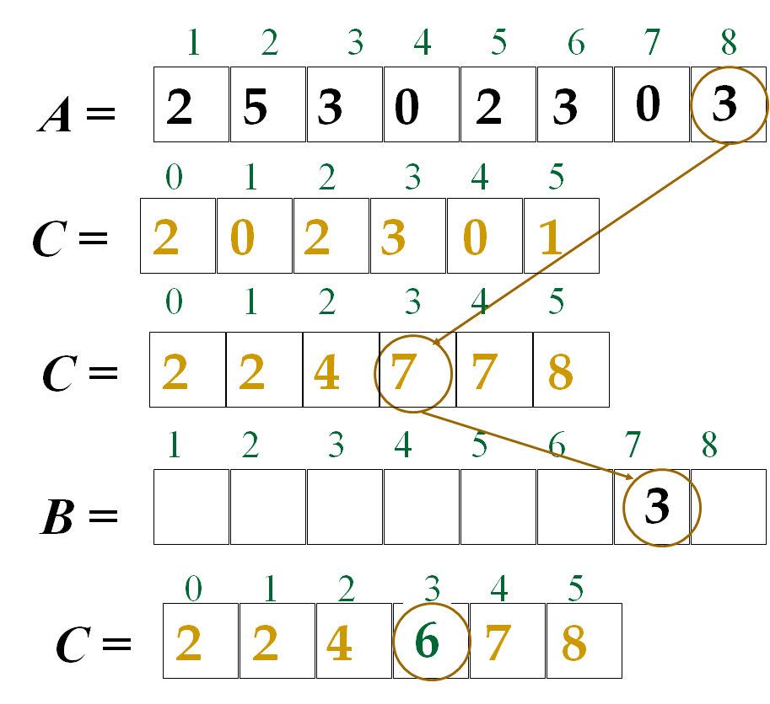
Counting Sort Example

Slide 9
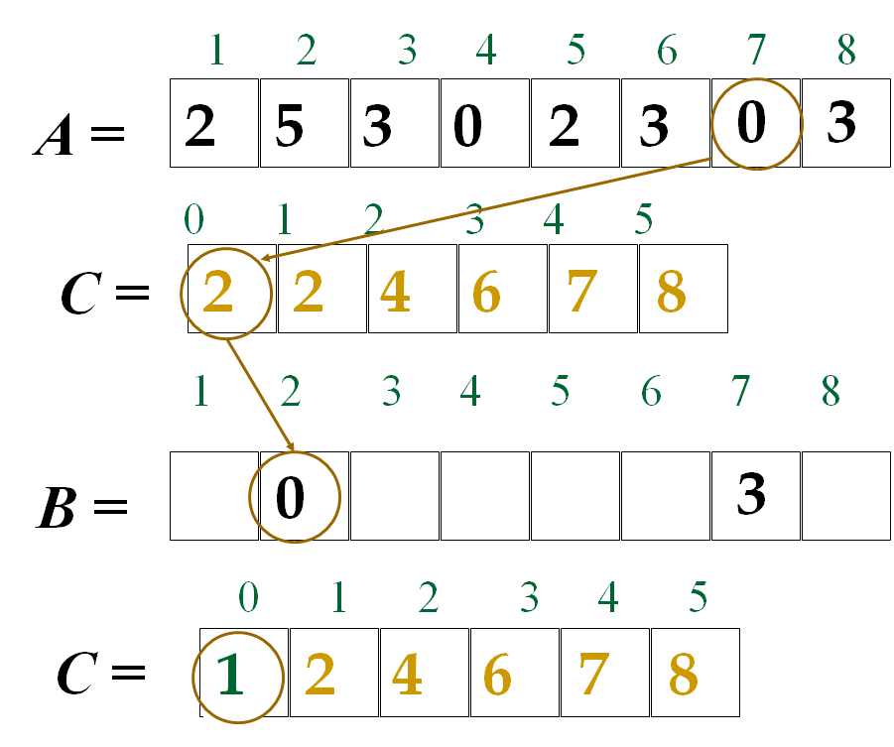
Counting Sort Example

Slide 10
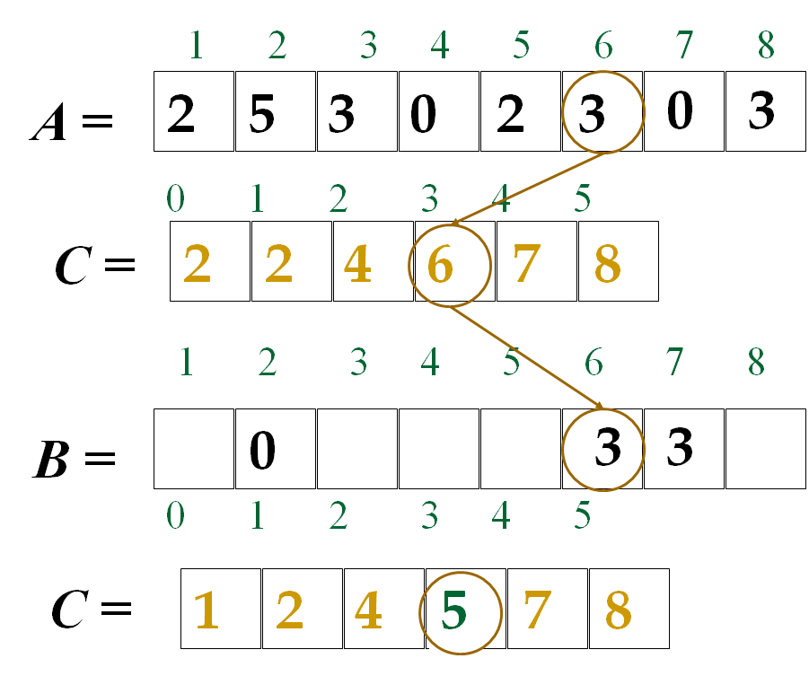
Counting Sort Example

Slide 11
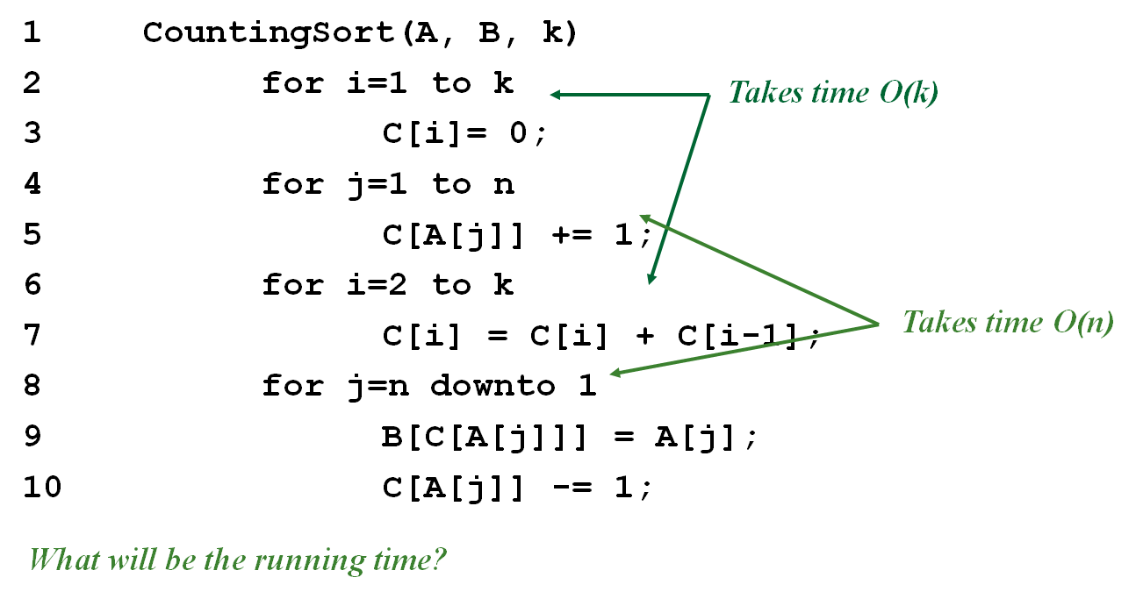
Counting Sort

Slide 12
Counting Sort
Total time: O(n + k)
Usually, k = O(n)
Thus counting sort runs in O(n) time
But sorting is (n lg n)!
No contradiction--this is not a comparison sort (in fact, there are no comparisons at all!)
Notice that this algorithm is stable
If numbers have the same value, they keep their original order

Slide 13
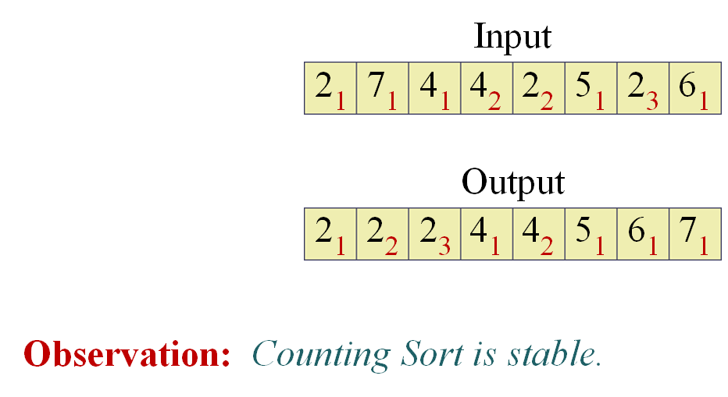
Stable Sorting Algorithms
A sorting algorithms is stable if for any two indices i and j with i < j and ai = aj, element ai precedes element aj in the output sequence.

Slide 14
Counting Sort
Linear Sort! Cool! Why don’t we always use counting sort?
Because it depends on range k of elements
Could we use counting sort to sort 32 bit integers? Why or why not?
Answer: no, k too large (2³² = 4,294,967,296)

Slide 15

Counting Sort
Assumption: input taken from small set of numbers of size k
Basic idea:
Count number of elements less than you for each element.
This gives the position of that number – similar to selection sort.
Pro’s:
Fast
Asymptotically fast - O(n+k)
Simple to code
Con’s:
Doesn’t sort in place.
Elements must be integers.
Requires O(n+k) extra storage.

Slide 16
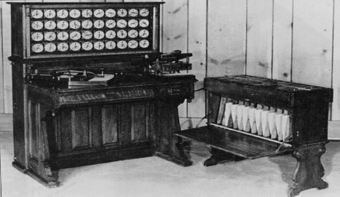
Radix Sort
Origin : Herman Hollerith’s card-sorting machine for the 1890 U.S Census
Digit-by-digit sort
Hollerith’s original (bad) idea : sort on most-significant digit first.
Good idea : Sort on least-significant digit first with auxiliary stable sort

Slide 17

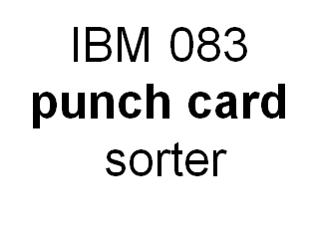
Radix Sort
Notes:
lHow did IBM get rich originally?
lAnswer: punched card readers for census tabulation in early 1900’s.
lIn particular, a card sorter that could sort cards into different bins
lEach column can be punched in 12 places
lDecimal digits use 10 places
lProblem: only one column can be sorted on at a time

Slide 18
Radix Sort
Key idea: sort the least significant digit first
RadixSort(A, d)
for i=1 to d
StableSort(A) on digit i

Slide 19
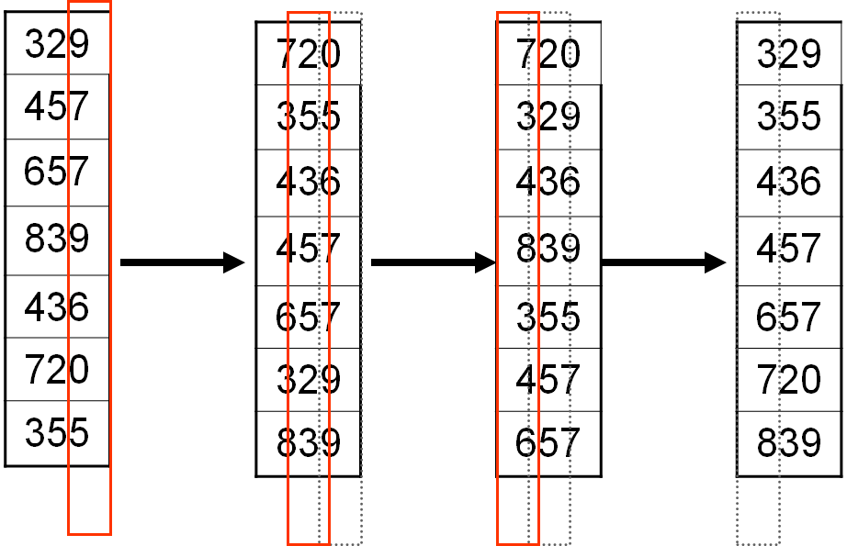
Radix Sort Example

Slide 20
Radix Sort
What is the running time of radix sort?
Each pass over the d digits takes time O(n+k), so total time O(dn+dk)
When d is constant and k=O(n), takes O(n) time
Stable, Fast
Doesn’t sort in place (because counting sort is used)

Slide 21
Radix Sort
Assumption: input has d digits ranging from 0 to k
Basic idea:
Sort elements by digit starting with least significant
Use a stable sort (like counting sort) for each stage
Pro’s:
Fast
Asymptotically fast (i.e., O(n) when d is constant and k=O(n))
Simple to code
A good choice
Con’s:
Doesn’t sort in place
Not a good choice for floating point numbers or arbitrary strings.

Slide 22
Bucket Sort
Assumption: input - n real numbers from [0, 1)
Basic idea:
Create n linked lists (buckets) to divide interval [0,1) into subintervals of size 1/n
Add each input element to appropriate bucket and sort buckets with insertion sort
Uniform input distribution O(1) bucket size
Therefore the expected total time is O(n)

Slide 23
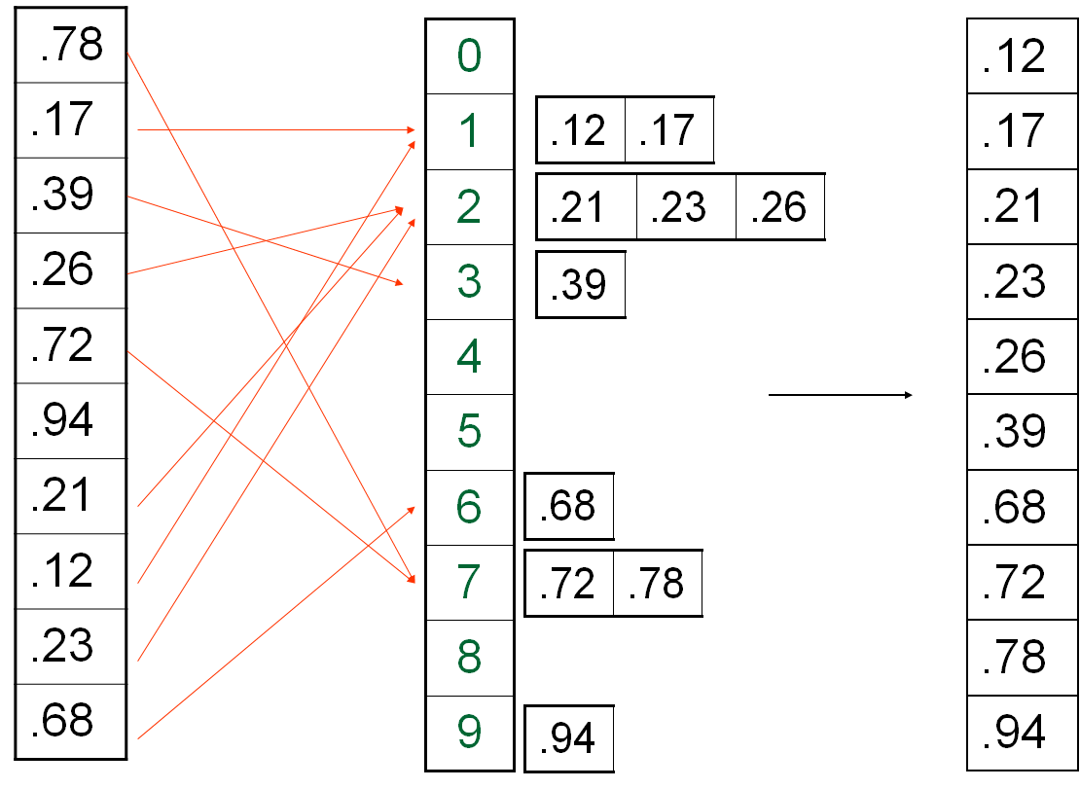
Bucket Sort Example

Slide 24
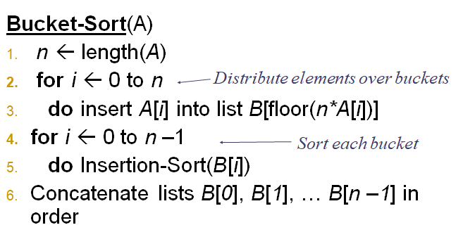
Bucket Sort

Slide 25
Bucket Sort-Running Time
All lines except line 5 (Insertion-Sort) take O(n) in the worst case.
In the worst case, O(n) numbers will end up in the same bucket, so in the worst case, it will take O(n2) time.
Lemma: Given that the input sequence is drawn uniformly at random from [0,1), the expected size of a bucket is O(1).
So, in the average case, only a constant number of elements will fall in each bucket, so it will take O(n) (see proof in book).
Use a different indexing scheme (hashing) to distribute the numbers uniformly.

Slide 26
Bucket Sort Review
Assumption: input is uniformly distributed across a range
Basic idea:
Partition the range into a fixed number of buckets.
Toss each element into its appropriate bucket.
Sort each bucket.
Pro’s:
Fast
Asymptotically fast (i.e., O(n) when distribution is uniform)
Simple to code
Good for a rough sort.
Con’s:
Doesn’t sort in place

Slide 27
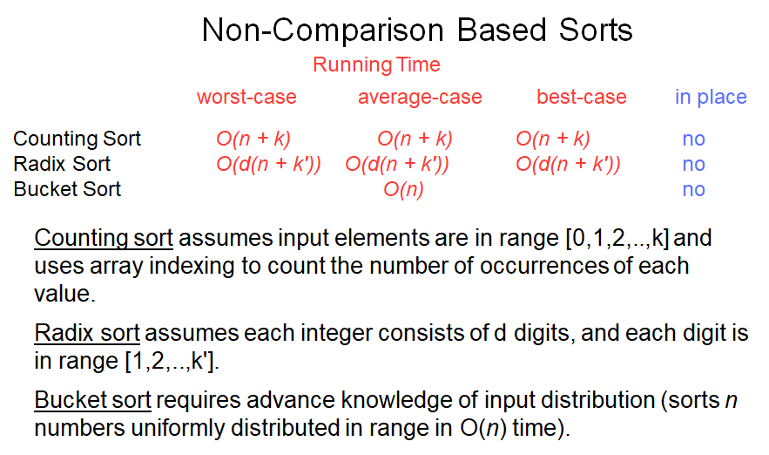
Summary of Linear Sorting

